Slide 1


SQL Social Science
Lucia Michielin
Edinburgh University
L.Michielin@sms.ed.ac.uk

Slide 2



Before starting …some practical info
Coffe break
Restrooms
Stickers

Slide 3
Plan of the Workshop
1. What is a relational database
2. Using DB Browser for SQLite
3. The Select Statement
4. Missing Data
5. Creating new columns
6. Aggregations
7. creating tables and view
8. Joins
9. Using DB tables in other environments

Slide 4

1. What is a relational database
Questions
What is a relational database?
What is a table?
What is a data type?
Why do tables have key columns?
What different types of keys are there?
How does the database represent missing data?
Objectives
Define a relational database
Compare with other types of databases
Understand the structure of a table
List the SQLite datatypes
Explain the purpose of a Schema
Explain Key fields
Understand the use of NULL

Slide 5

1. What is a relational database
What a Relational Database is?
A relational database stores data in relations made up of records with fields. The relations are usually represented as tables; each record is usually shown as a row, and the fields as columns. In most cases, each record will have a unique identifier, called a key, which is stored as one of its fields. Records may also contain keys that refer to records in other tables, which enables us to combine information from two or more sources.

Slide 6

1. What is a relational database
What is a table?
As were have noted above , a single table is very much like a spreadsheet. It has rows and it has columns. A row represents a single observation and the columns represents the various variables contained within that observation. The rows may or may not have an index or key column as a means of uniquely identifying a row. The columns typically have a name associated with them indicating the variable name, or in one of the examples we are going to use a question number from a survey. A column always represents the same variable for each row contained in the table.
Because of this the data in each column will always be of
the same type, such as an Integer, or Text value for all rows
in the table. Datatypes are discussed in the next section.

Slide 7
1. What is a relational database
Data type | Description
CHARACTER(n) | Character string. Fixed-length n
VARCHAR(n) or CHARACTER VARYING(n) | Character string. Variable length. Maximum length n
BINARY(n) | Binary string. Fixed-length n
BOOLEAN | Stores TRUE or FALSE values
VARBINARY(n) or BINARY VARYING(n) | Binary string. Variable length. Maximum length n
INTEGER(p) | Integer numerical (no decimal).
SMALLINT | Integer numerical (no decimal).
INTEGER | Integer numerical (no decimal).
BIGINT | Integer numerical (no decimal).
DECIMAL(p,s) | Exact numerical, precision p, scale s.
NUMERIC(p,s) | Exact numerical, precision p, scale s. (Same as DECIMAL)
FLOAT | Approximate numerical
DOUBLE PRECISION | Approximate numerical
DATE | Stores year, month, and day values
TIME | Stores hour, minute, and second values
TIMESTAMP | Stores year, month, day, hour, minute, and second values
INTERVAL | Composed of a number of integer fields, representing a period of time, depending on the type of interval
ARRAY | A set-length and ordered collection of elements
MULTISET | A variable-length and unordered collection of elements
XML | Stores XML data

Slide 8
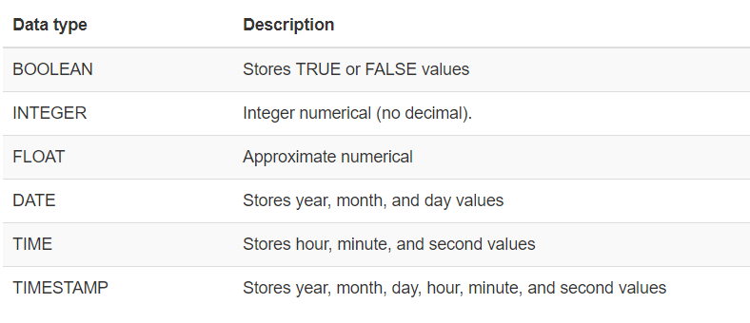
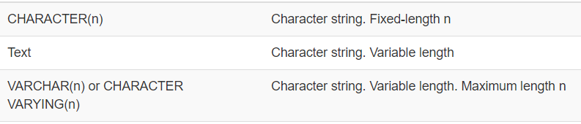
1. What is a relational database

Slide 9

1. What is a relational database
Database Design
Every row-column combination contains a single atomic value, i.e., not containing parts we might want to work with separately.
One field per type of information
No redundant information
Split into separate tables with one table per class of information
Needs an identifier in common between tables – shared column - to reconnect

Slide 10

1. What is a relational database
What is the relationship of your data?
1 to 1: Party name and Party Leader
1 to n: The same journal can be bought by n families
n to n: different families can buy different journals

Slide 11
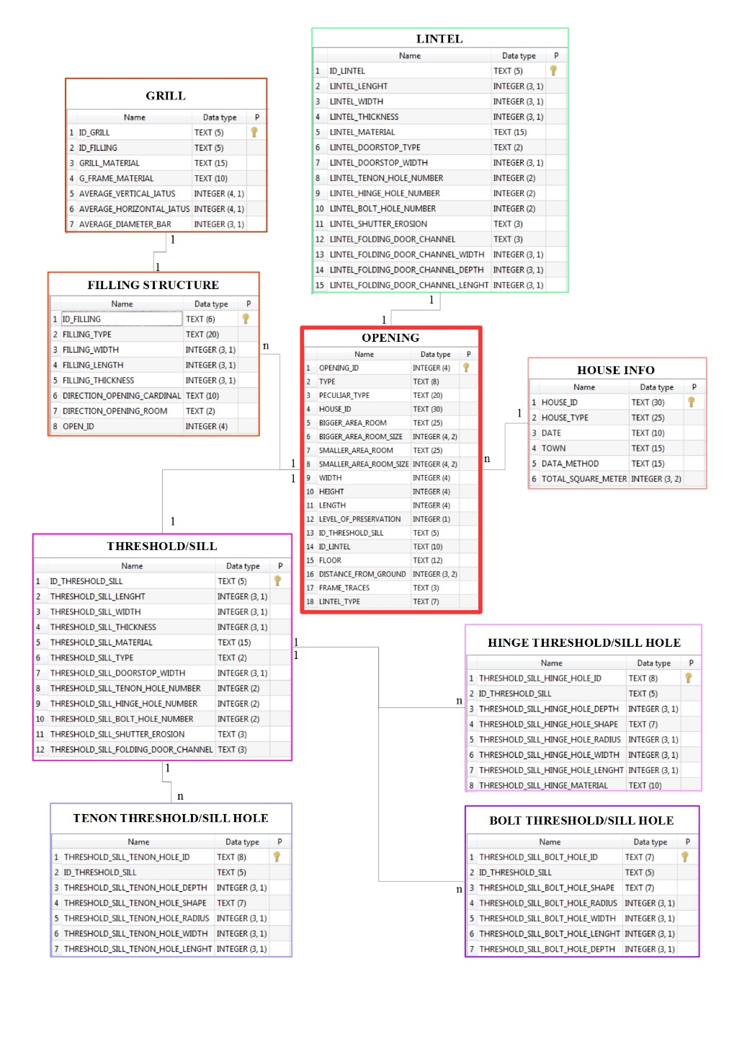

Keying is the key
1. What is a relational database
Primary key
Secondary/Foreing key

Slide 12

1. What is a relational database
How does the database represent missing data?
All relational database systems have the concept of a NULL value. NULL can be thought of as being of all data types or of no data type at all. It represents something which is simply not known.
When you create a database table, for each column you are allowed to indicate whether or not it can contain the NULL value. Like primary keys, this can be used as a form of data validation.
In many real life situations you will have to accept that the data isn’t perfect and will have to allow NULL or missing values in your table.
In DB Browser we can indicate how we want NULL values to be displayed. In SQL queries you can specifically test for NULL values.
We will look at missing data in more detail in a later episode.

Slide 13

2. Using DB Browser for SQLite
Familiarise yourself with the DB Browser interface
Does anyone has the software installed and running? And the the dataset?
https://datacarpentry.org/sql-socialsci//data/SN7577.sqlite

Slide 14
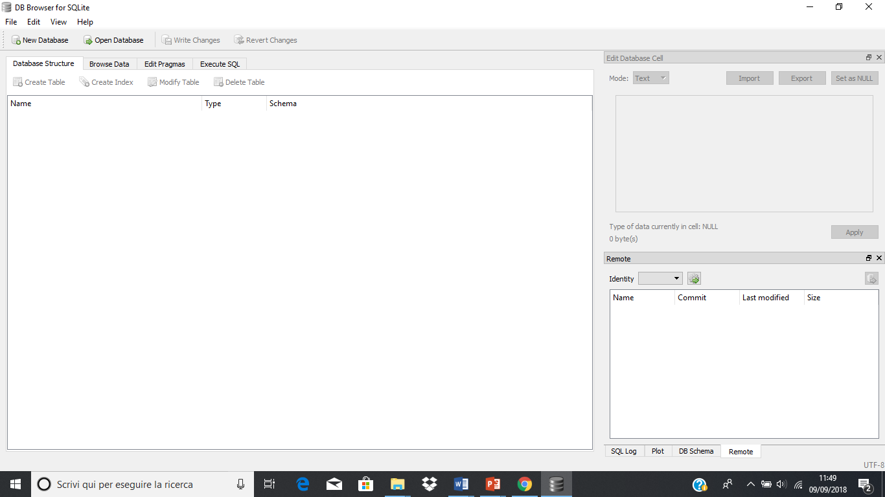
2. Using DB Browser for SQLite
The Initial screen

Slide 15
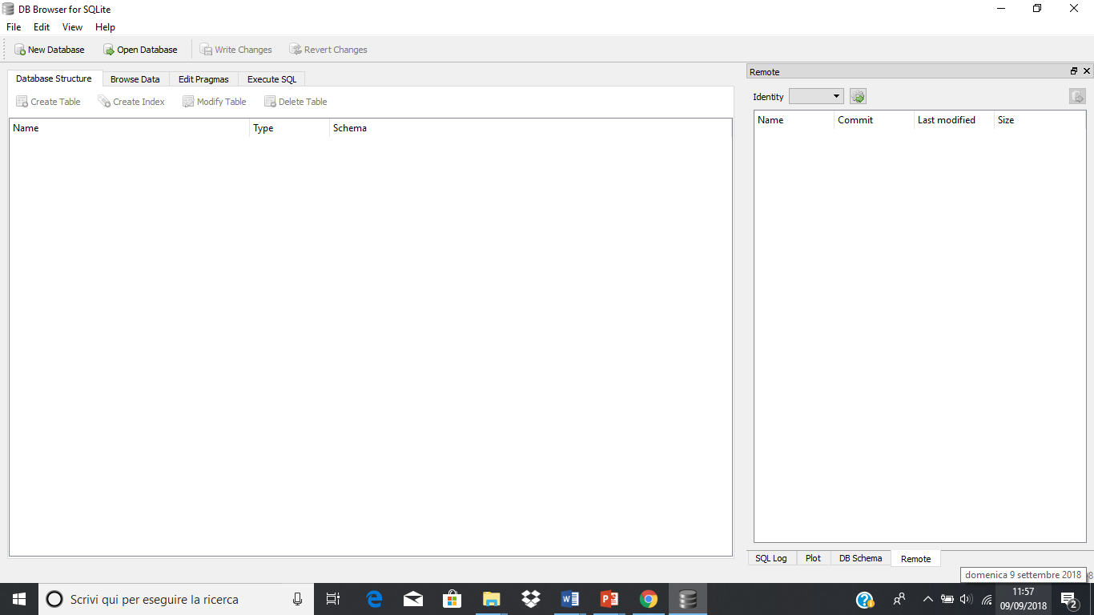
2. Using DB Browser for SQLite
Initial changes to the layout.

Slide 16
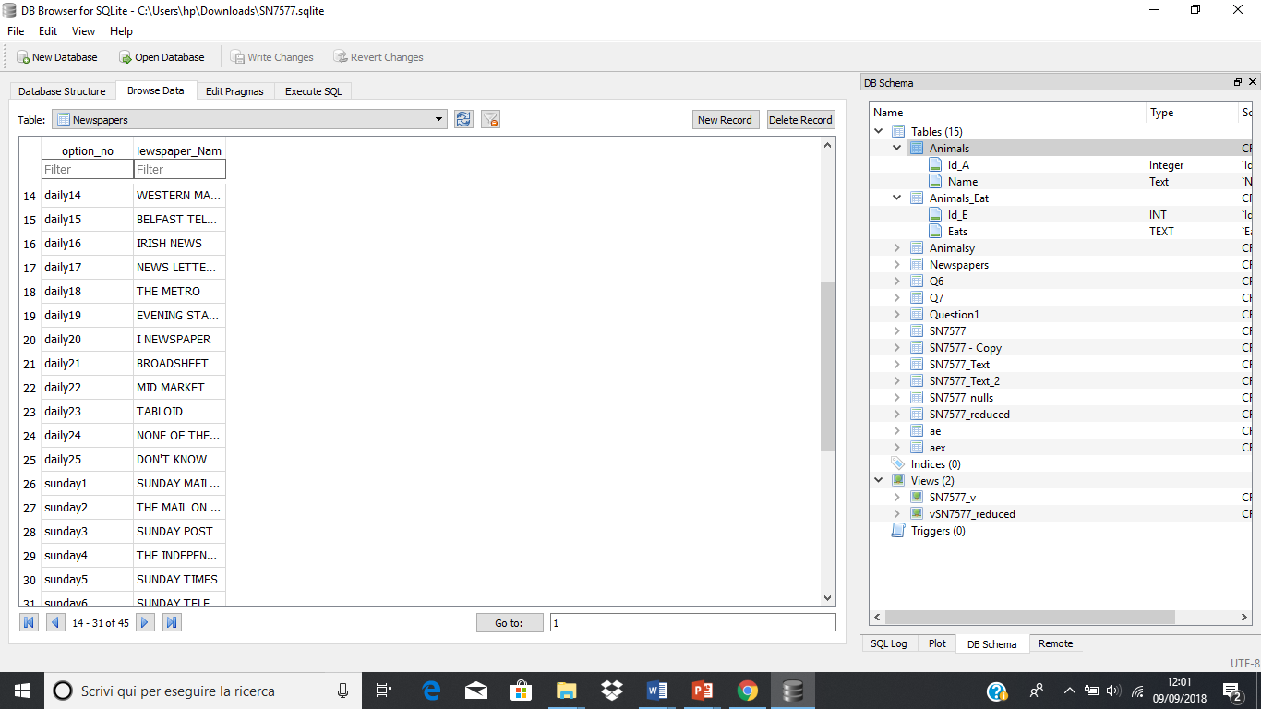
2. Using DB Browser for SQLite
Open an
Existing Database

Slide 17
2. Using DB Browser for SQLite
Quering a database
On the toolbar there are five buttons. Left to right they are:
Open Tab (creates a new tab in the editor)
Open SQL file (allows you to load a prepared file of SQL into the editor - the tab takes the name of he file)
Save SQL file (allows you to save the current contents of the active pane to the local file system)
Execute SQL (Executes all of the SQL statements in the editor pane)
Execute current line (Actually executes whatever is selected)
Always end your query with a ;

Slide 18
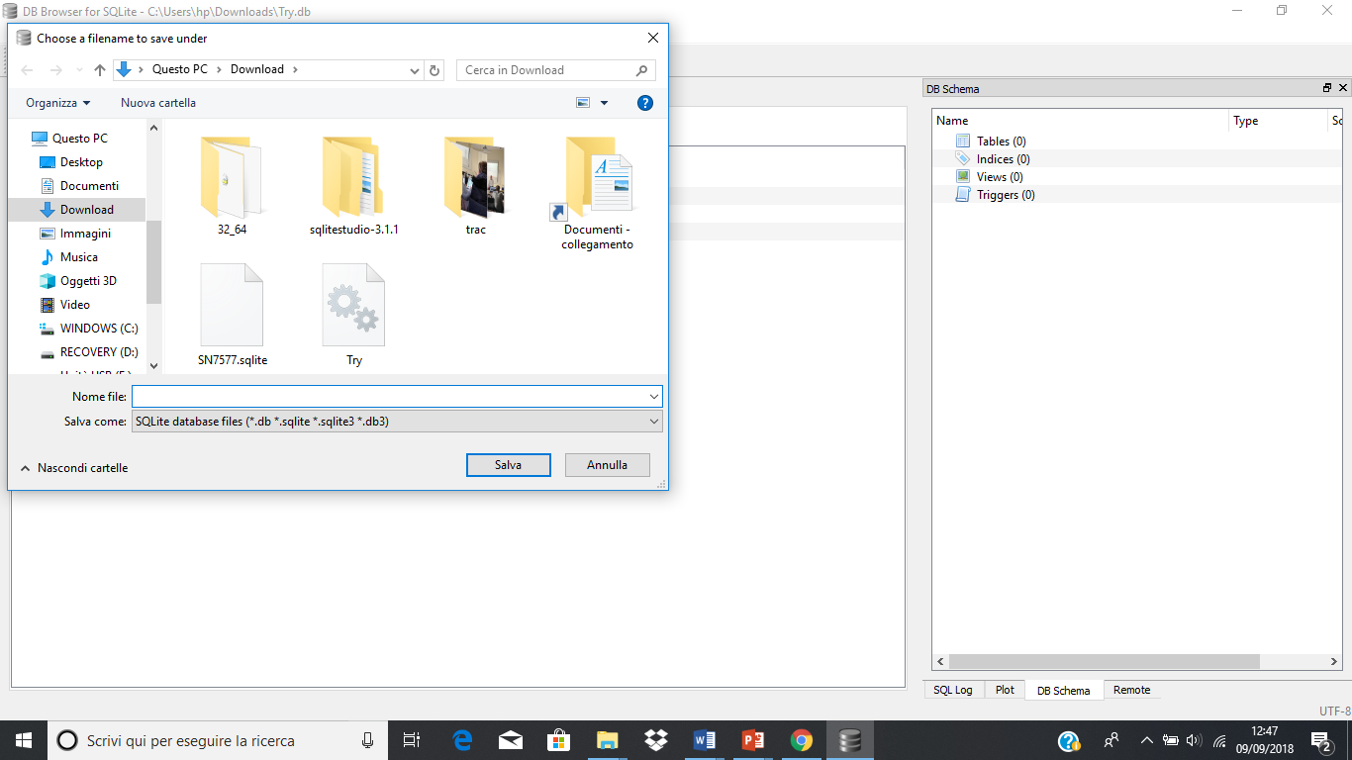
2. Using DB Browser for SQLite
Create a new Database
Write Changes & Revert Changes

Slide 19
2. Using DB Browser for SQLite
Key Points
The DB Browser for SQLite application allows you to connect to an existing database or create a new database
When connected to a database you can create new tables
When connected to a database you can write and run SQL queries and view the results
You can save the results of a query to a file

Slide 20
3. The Select Statement
Questions
What is SQL?
How can I return specific columns from a table?
How can I return specific rows from a table?
Objectives
Define SQL
Explain how SQL is used to access relational database tables
Understand the difference between DDL and DML
Create simple SQL queries to return rows and columns from existing tables
Construct more complex logical expressions for use in where clauses
Return sorted results from a query

Slide 21

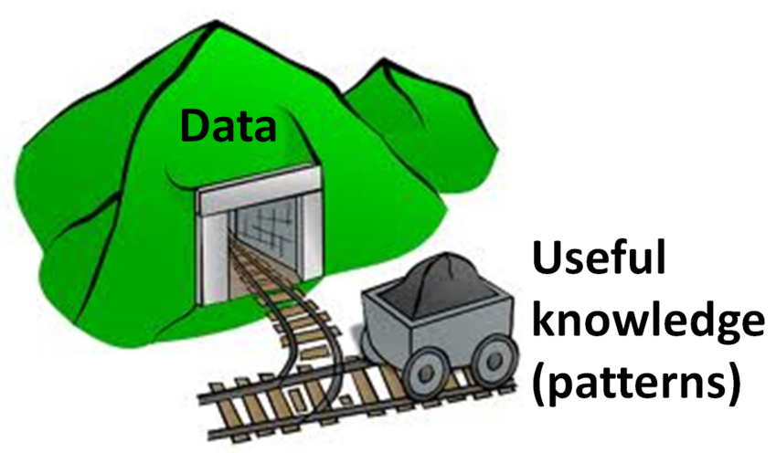
3. The Select Statement
From Data organising
to
Data mining
What is SQL?
SQL or Structured Query Language is an international standard for manipulating data in a relational database. Each Relational Database system like Oracle, MySQL or SQLite implements its own variation of the standard.
For the type of commands and queries that we will want to write, all of the implementations are much in agreement.
Essentially you only have to learn SQL once.

Slide 22
3. The Select Statement
SQL and Relational database tables
The strength of SQL is that a single SQL statement or query can request data be returned from one or many of the tables in the database. You can essentially define the relationships between tables on-the-fly as part of your query statement.
DDL VS DML
DDL stands for Data Definition Language. It is the set of SQL comands used to create alter of delete database objects such as tables.
DML stands for Data Manipulation Language. Principally this is the SELECT command which is used to extract data items from one or more of the database tables.

Slide 23

3. The Select Statement
Simple SQL queries using the Select statement
SQL queries repository
SELECT colnames
FROM tablename
WHERE conditions
GROUP BY colnames
HAVING conditions
ORDER BY colnames

Slide 24

3. The Select Statement
Limiting Result
What if we want to see just the first 5, 10 etc rows
SELECT
Which information I need to visualize
LIMIT
FROM
Where these info are located

Slide 25
3. The Select Statement
Challenge
Write a query that returns the first 5 rows from the SN7577 table with only the columns Q1,Q2,Q3,Q4 and numage.
Solution:
SELECT Q1,Q2,Q3,Q4, numage
FROM SN7577
LIMIT 5;

Slide 26

3. The Select Statement
Filtering
What if you want to see just the data meeting a certain criteria
i.e. certain values or ranges within one or more columns.
Works both for alphanumeric data than for numeric (we can select only the data of people answering 2 to the Q1)
WHERE
Combine more than one condition with AND and OR
Also using brackets to specify priority

Slide 27
3. The Select Statement
BETWEEN or IN operators
Select Q1, Q3, Q4
From SN7577
Where Q1 > 5 and Q1 < 8;
Select Q1, Q3, Q4
From SN7577
Where Q1 Between 5 and 8;
Select Q1, Q3, Q4
From SN7577
Where Q1 In (5, 6, 7, 8);
N.B. No need to be in order

Slide 28
3. The Select Statement
Challenge
In the SN7577 table the values of the web1, web2, web3, web4 columns are all -1, 0 or 1. The numage columns can be any value between 0 and 95.
Write a query which returns the web1, web2, web3, web4 and numage columns from the SN7577 table. The web1, web2, web3, web4 values should all be either 0 or 1 and the numage values should be between 30 and 40 inclusive. There are many ways of doing this, but try to use two different inequalities, an IN clause and a BETWEEN clause.
Solution:
SELECT web1, web2, web3 , numage
FROM sn7577
WHERE web1 >= 0 and web2 in (0, 1) and web3 <> -1 and numage between 30 and 40;

Slide 29
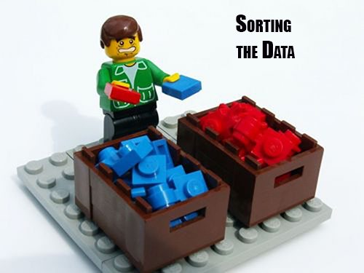
3. The Select Statement
Sorting
We can also sort the results of our queries
How do we want our data to be displayed
ASC
DESC
ORDER BY

Slide 30
3. The Select Statement
Key Points
Strictly speaking SQL is a standard, not a particular implementation
SQL implementation are sufficiently close that you only have to learn SQL once
The DDL concreate tables structs are used to and other database objects
The DML constructs, typically the SELECT statement is used to retrieve data from one or more tables
The SELECT statement allows you to ‘slice’ and ‘dice’ the columns and rows of the dataset so that the query only returns the data of interest

Slide 31
4. Missing Data
Questions
How can I deal with missing data?
Objectives
Recognize what the database sees as missing data
Understand that the original data source may represent missing data differently
Define strategies for dealing with missing data

Slide 32
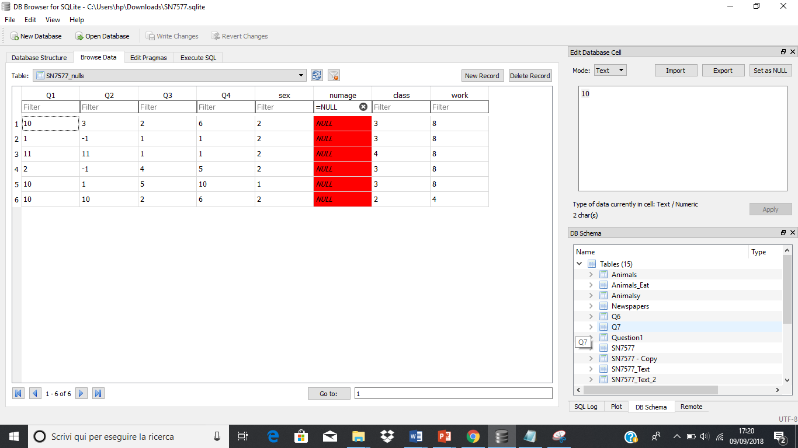
4. Missing Data

Slide 33
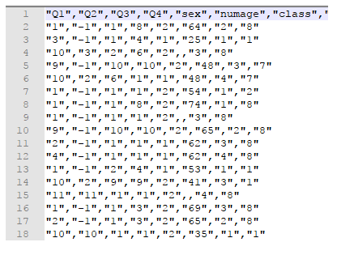
4. Missing Data
The original Csv file
You can see that in lines 4, 9 and 15 there are consecutive ‘,’s where the numage values should be. These values are missing from the data.

Slide 34
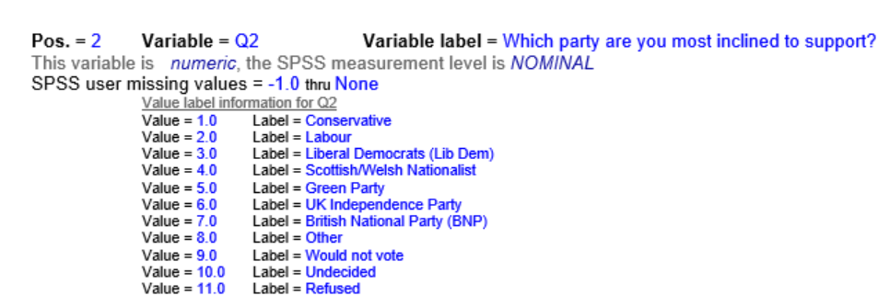
4. Missing Data
Other representations of missing data
You can see from the extract of that there are several ‘-1’ values in the Q2 field indicating the original data had missing values. These have been replaced with ‘-1’ in the data provided. It is your responsibility to understand that these should be treated as NULL values.
This is very different from rows which have a value of 11 for column Q2 (3rd row from bottom). The value 11 means that the participant refused to provide an answer. The refusal may not tell you which party they are inclined to vote for, but it does convey some kind of information. A NULL value tells you nothing.
Different statistical packages like SPSS or Stata have their own way of representing NULL values such as -99 or -999. You need to be aware of how NULL values in your dataset are being represented.

Slide 35
4. Missing Data
Dealing with missing data
Once you know how NULL values are being represented in your data you can find them and allow for them in your SQL queries.
SELECT *
FROM SN7577_nulls
WHERE Q2 = 11;
39 lines
you can use the IS operator or IS NOT and the NULL keyword
SELECT *
FROM SN7577_nulls
WHERE Q2 = -1;
returns 898 rows, nearly 70% of the sample.
SELECT *
FROM SN7577_nulls WHERE numage IS NULL;

Slide 36
4. Missing Data
Key Points
You should expect missing data
You need to know how missing data is being represented in your dataset
Database systems always represent what they consider to be missing data as NULL
You can explicitly test for NULL values in your data
You may need other tests for different representations of NULL

Slide 37
5. Creating new columns
Questions
How can I add new columns with derived values in the query results?
How can I give a column a new name?
How do I use built-in functions to create new values?
How can I create binned results?
How can I add new columns with derived values in the query results?
How can I give a column a new name?
How do I use built-in functions to create new values?
How can I create binned results?
Objectives
Create new columns in the query output
Rename columns in the query output
Use built-in functions to create new values
Use SQL syntax to conditionally create new values
Use SQL syntax to create a new column of ‘binned’ values

Slide 38
5. Creating new columns
Creating new columns
In addition to selecting existing columns from a table, you can also create new columns in the query output based on the existing columns. These new columns only exist in the output. The table used in the query is not changed in any way.
The SN7577 table has a series of 25 columns (daily1 - daily25) with values of 0 or 1 depending on whether or not a particular newspaper is read (If you want to know which newspaper is which, they are listed in the Newspapers table)
What we want to know is how many newspapers a given household (row in the SN7577 table) reads.
We could run the query below and count up the ones?
SELECT daily1, daily2, daily3, daily4, daily5, daily6, daily7, daily8,daily9, daily10, daily11, daily12, daily13, daily14, daily15,daily16, daily17, daily18, daily19, daily20,daily21, daily22,daily23, daily24, daily25
FROM SN7577;
SELECT (daily1 + daily2 + daily3 + daily4 + daily5 + daily6 + daily7 + daily8 +daily9 + daily10 + daily11 + daily12 + daily13 + daily14 + daily15 +daily16 + daily17 + daily18 + daily19 + daily20 + daily21 + daily22 +daily23 + daily24 + daily25)
FROM SN7577;

Slide 39

5. Creating new columns
Aliases
As queries get more complex names can get long and unwieldy (as we saw before). To help make things clearer we can use aliases to assign new names to things in the query.
AS
Table names
Column names
SELECT (daily1 + daily2 + daily3 + daily4 + daily5 + daily6 + daily7 + daily8 +
daily9 + daily10 + daily11 + daily12 + daily13 + daily14 + daily15 +
daily16 + daily17 + daily18 + daily19 + daily20 + daily21 + daily22 +
daily23 + daily24 + daily25) AS Total_dailies
FROM SN7577;

Slide 40
5. Creating new columns
Using built-in functions to create new values
In addition to using simple arithmetic operations to create new columns, you can also use some of the SQLite built-in functions. Full details of the available built-in functions are available from the SQLite.org website here.
We will look at some of the arithmetic and statistical functions when we deal with aggregations in a later lesson. For now we will focus on some text functions.
To do this we will use the SN7577_Text table. This table has the same information in it as the SN7577 table but many of the numeric values have been replaced with their text equivalents. It also has a ‘key_id’ column added as a primary key. To find out how these text equivalents map to the numeric values you need to refer to the SN7577 data dictionary document which can be downloaded from here.

Slide 41

Cast Function
5. Creating new columns
There will be some circumstances where a text ‘number’ will cause problems, like in arithmetic. We can avoid such problems by using the castfunction. This tells SQLite to change the data type of a data item. It is most commonly used in the way we will use it in changing a text string into an integer or real value.
The format of the cast function is shown in the following example.
CAST
SELECT numage,
cast(numage as Integer) int_numage
FROM SN7577_Text;

Slide 42

Substr and Instr
5. Creating new columns
The SUBSTR() function extracts a substring from a string (starting at any position).
The INSTR() function returns the position of the first occurrence of a string in another string.
SELECT Q5axv,
NOT (substr(Q5axv, 1,2) = "no" ) as Q5axv_value
FROM SN7577_Text;
SELECT Q5axv,
NOT (instr(Q5axv, "no")) as Q5axv_value
FROM SN7577_Text;
Explanation
The substr function takes 2 characters starting at character 1 from the value in Q5axv. This is compared with the string ‘no’. The result of the comparison is either the boolean value True or the boolean value False. SQLite represents the boolean values True and False as 1 and 0. However as we want to return 0 if the expression is True we need to NOT the whole expression.

Slide 43
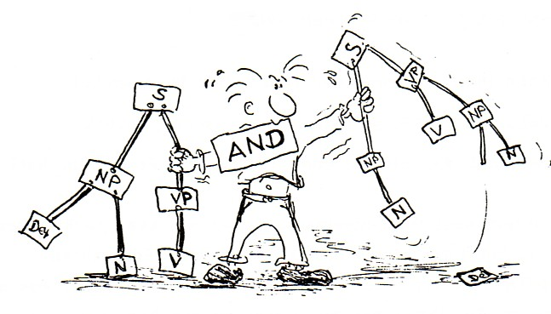
5. Creating new columns
Using SQL syntax to conditionally create new values
The SQLite SQL dialect has a programming construct called the CASE Statment. This is in fact common to many other programming languages as well. It can be used in two different ways, both of which can be used to create new columns in a queries’ result set.
First we will use the case statement to accomplish what we just did with the substr and instr functions.
allows you to check if various values are equal to the value in the field given after the case keyword.
SELECT Q5axv ,
case Q5axv
when "no null" then 0
when "null" then 1
end as Q5axv_bool
FROM SN7577_Text;

Slide 44

5. Creating new columns
Using SQL syntax to create ‘binned’ values
SELECT numage ,
case
when numage between 18 and 24 then "18 - 24"
when numage between 25 and 34 then "25 - 34"
when numage between 35 and 44 then "35 - 44"
when numage between 45 and 54 then "45 - 54"
when numage between 55 and 59 then "55 - 59"
when numage between 60 and 64 then "60 - 64"
when numage >= 65 then "65+"
else
"Under age"
end as numage_range
FROM SN7577;
It is often the case that we wish to convert a continous variable into a an discrete factor type variable. In SN7577 you can see this being done in the numage and the age variables.
We can use a case statement to create this type of effect. The example below re-creates the age values used in the SN7577_Text table with the addition of an “Under age” category for those less than 18 years old.

Slide 45

5. Creating new columns
Challenge
Try running the query above and check the results.
Are there any “Under age” entries?
You can look for “Under age” entries by scanning down the results.
A better way would be to adding ORDER BY numage at the end of the query and then they will appear at the top of the results.
You could also have written a separate query Select numage from SN7577 where numage < 18

Slide 46
5. Creating new columns
Key Points
New result columns can be created using arithmetic operators or builtin functions
New columns have to be given names or Alias’
The Case coding structure can be used to create new columns
The new columns are only in the query results. The original table is not changed
previous episode

Slide 47
6. Aggregations
Question
How can I summaries the data in my tables
Objectives
Use the Distinct keyword to get a unique set of values
Use the ‘group by’ clause to summaries data
Use built-in statistical functions to provide column summaries
Use the ‘having’ clause to provide selection criteria to the summary values
Understand the difference between the ‘where’ and the ‘having’ clauses

Slide 48

6. Aggregations
Aggregation allows us to combine results by grouping records based on value and calculating combined values in groups
Calculate and sum all the possible combination of values
MIN | returns the smallest value in a given column
MAX | returns the largest value in a given column
SUM | returns the sum of the numeric values in a given column
AVG | returns the average value of a given column
COUNT | returns the total number of values in a given column
COUNT(*) | returns the number of rows in a table

Slide 49

6. Aggregations
The Distinct keyword
For the SN7577 table the allowable values in many of the columns are listed in the SN7577 data dictionary document. But this doesn’t mean that they all actually appear in the data.
To obtain a list of unique values in a particular column you can use the Distinct keyword. We will use the text version of the SN7577 table for these examples.
For Q1 How would you vote if there were a General Election tomorrow? there are 11 possibilities listed and potentially another (-1) for a missing value.
To find out which values are in the data we can use the query;
SELECT DISTINCT

Slide 50
6. Aggregations
Challenge
Q3 asks for the likelihood of voting on a scale of 1 - 10 (10 - Absolutely certain to vote). Write a query which shows all of the combinations of voting intentions (Q1) and likelihood of voting (Q3).
SELECT DISTINCT Q1, Q3
FROM SN7577_Text
ORDER BY Q1;

Slide 51

6. Aggregations
GROUP BY
The GROUP BY statement is often used with aggregate functions (COUNT, MAX, MIN, SUM, AVG) to group the result-set by one or more columns.
You really want to know How many of each of the values there are!
SUMMARISE YOUR DATA
The grouping will take place based on the order of the columns listed in the GROUP BY clause. There will be one row returned for each unique combination of the columns mentioned in the GROUP BY clause

Slide 52

6. Aggregations
HAVING Keyword
Filter the results based on aggregate functions.
E.g. we can request to only return information about species with a count higher than 10
SELECT Q1 ,
sum(daily3) as Telegraph_reader
FROM SN7577
GROUP BY Q1
HAVING Telegraph_reader > 5;
The HAVING keyword works exactly like the WHERE keyword, but uses aggregate functions instead of database fields.
If you use AS in your query to rename a column, HAVING can use this information to make the query more readable. For example, in the above query, we can call the COUNT(species_id)by another name, like occurences.

Slide 53
6. Aggregations
x
Challenge 3
In the UK the ‘Telegraph’ is regarded as a right-wing newspaper and the Conservatives are considered to be a right-wing political party.
Do the results of the query above support this?
The ‘Mirror’ is a left-wing newspaper and Labour are considered to be a left-wing political party.
Re-write the query above to see which group of supporters are more likely to read the Mirror
You can browse the Newspapers table to find out which of the daily columns refers to the Mirror. You can browse the Question1 table to find the party names represented by the values in Q!
Solution:
SELECT Q1 ,
sum(daily12) as Mirror_reader
FROM SN7577
GROUP BY Q1
HAVING Mirror_reader > 5;

Slide 54
7. creating tables and views
Questions
What is the difference between a table and a view?
How can I create a table using the SQLite plugin GUI?
How can I create a table or view in the SQLite plugin using SQL code?
How can I add records of data to a table?
Objectives
Understand the differences and similarities between Tables and Views
Create table schemas using SQLite plugin GUI
Create table schemas and views using SQL code
Populate a table using SQL code
Populate a table from a file of data using the SQLite plugin GUI

Slide 55
7. creating tables and views
Using SQL code to create tables
In relational databases, tables have to be created before you can add data to them. The table definition that you create is referred to as the Schema of the table.
The schema can contain many different properties of the table and the data that it does/will contain
We will create two simple tables which we will use in a later episode.
Lets create our simple tables first. The code below creates a table called ‘Animals’ with two columns, the first is called ‘Id_A’ and is an Integer and the second is called ‘Name’ and is of type Text.
As this table already exists in the database, it will fail if you try to run the SQL code below, complaining that the table already exists. Instead of running it as-is, change the table name slightly (perhaps include your initials as a prefix).
CREATE TABLE Animal
( Id_A Integer,
Name Text
);

Slide 56
7. creating tables and views
Challenge
Run the code above to create the Animals table
Create another table called ‘Animals_Eat’ with two columns, ‘Id_E’ which is an integer and ‘Eats’ which is text.
CREATE TABLE Animals_Eat
( Id_E Integer,
Eats
);

Slide 57
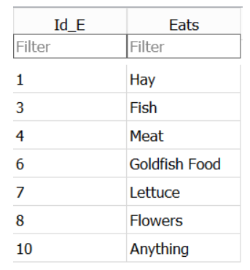

7. creating tables and views
Challenge
Add the following rows of data to the Animal_Eats table
INSERT INTO command
The next step is to insert data into them.
To do this we can use the INSERT INTO command
The code below will insert seven rows into the Animals table.
INSERT INTO Animals_Eat
VALUES (1, "Hay"),
(3, "Fish"),
(4, "Meat"),
(6, "Goldfish Food"),
(7, "Lettuse"),
(8, "Flowers"),
(10, "Anything")
INSERT INTO Animals (Id_A, Name)
VALUES (1, "Elephant"),
(2, "Monkey"),
(3, "Cat"),
(4, "Dog"),
(8, "Goat"),
(10, "Pig"),
(11, "Mouse")

Slide 58
7. creating tables and views
Creating tables from other tables
Whenever you write a Select query and run it, the results are always in the form of a table. In the results pane, you can see the column names and the rows of data in the results.
This provides a very easy way of creating new table based on the results of a query.
The following query selects a few of the columns from the SN7577 table
CREATE Table SN7577_reduced AS
SELECT Q1,
Q2,
Q3,
Sex,
Age,
Class

Slide 59
7. creating tables and views
Using the DB Browser application to create tables
What if I already have all my data on excel tables?
For large datasets this is a very common approach to enter them as CSV files and then connect them
From the File menu select Import and then ‘Table from CSV file’. This will start the ‘Import CSV file’ wizard and you will be asked to select the file of data you wish to import from a standard Windows file open dialog.
After you have selected the file, you will be shown the ‘Import CSV file’ window which will allow you to set a name for the table (the default is taken from the filename). You will see the first few rows of the data and there are a few options which can be changed if needs be.

Slide 60
7. creating tables and views
The Import CSV wizard
PK - Or Primary Key, a unique identifier for the row.
AI - Or Auto Increment. This isn’t really applicable to tables created in this way, i.e. the creation of the schema immediatley followed by loading data from a file. It is usally used to generate uniques values for a column which could then act as a primary key
Not Null - If this is checked then it means that there must be a value for each row in this column. In real datasets missing values are quite common and we have already looked at ways of dealing with them when they occur in tables. If you you were check this box and the data did have missing values for this column, the record from the file would be rejected and the load of the file will fail.
U - Or Unique. This allows you to say that the contents of the columnn, which is not the primary key column has to have unique values in it.
Default - This is used in conjunction with ‘Not Null’, if a value is not provided in the dataset, then if provided, the default value for that column will be used.
Check - This allows you to specify a constraint on the vlaues entered for the column. You could restrict the range of values or compare the value with other columns values.

Slide 61

7. creating tables and views
Saving Queries for Future Use
imagine that my project only covers the data stored in Q1-Q4, sex , age, and Class
Sometimes you need to repeat the same operation. SQL comes with a very powerful mechanism to do this: views. Views are a form of query that is saved in the database, and can be used to look at, filter, and even update information.
One way to think of views is as a table, that can read, aggregate, and filter information from several places before showing it to you.
SELECT Q1,Q2,Q3,Sex, Age, Class
FROM SN7577;
CREATE view SN7577_reduced AS
SELECT Q1,Q2,Q3,Sex, Age, Class
FROM SN7577;
SELECT*
FROM SN7577_reduced
WHERE Q1=11;
CREATE VIEW viewname AS

Slide 62

8. Joins
Questions
What is meant by joining tables?
Why would I want to join tables?
What different types of joins are there?
How do Joins help you discover missing data or gaps in the data
Objectives
Understand the structure of a joined table
Familiarity with the different join types
Use different join types in analysing your data
Understand what other join types can tell you about your
data

Slide 63

8. Joins
Joins
To combine data from two tables we use the SQL JOIN command, which comes after the FROM command.
The JOIN command on its own will result in a cross product, where each row in first table is paired with each row in the second table. Usually this is not what is desired when combining two tables with data that is related in some way.
For that, we need to tell the computer which columns provide the link between the two tables using the word ON. What we want is to join the data with the same species codes.
The two table to be joined need to share a field (normally primary and foreign key respectively)

Slide 64
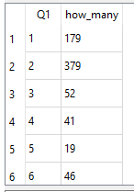
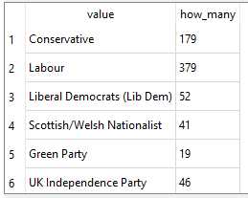
8. Joins
In our case if we want to know the intention of vote we will have to use a query similar to this
SELECT Q1,
count(*) as how_many
FROM SN7577
GROUP BY Q1;
You can use also WHERE
SELECT q.value,
count(*) AS how_many
FROM SN7577 AS s
JOIN Question1 AS q
ON q.key = s.Q1
GROUP BY s.Q1
Not User friendly! I will always have to remember what correspond to what

Slide 65
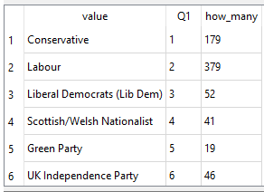
8. Joins
NB Order of execution
Another note for ordering. We don’t actually have to display all the columns of the join.
We can do this because sorting occurs earlier in the computational pipeline than field selection.
The computer is basically doing this:
Filtering rows according to WHERE
Sorting results according to ORDER BY
Displaying requested columns or expressions.

Slide 66
8. Joins
Challenge 1
Change the SQL above so that the group by clause is the value column from the Question1 table. Run the query. How are the results different?
Can you change the SQL so that table alias’ are not used? Does this aid readability or not?
Solution
SELECT Question1.value,
count(*)
FROM SN7577
JOIN Question1
ON Question1.key = SN7577.Q1
GROUP BY Question1.value;

Slide 67

8. Joins
Standard Join
=
INNER JOIN

Slide 68
8. Joins
Using different join types in analysing your data
Data may have come from disparate sources, in that they do not form part of a planned relational database. It has been your decision to bring together (join) the data in the tables.
In order to do this at all you must be confident that the tables of data do have columns which have a common set of values that you can join on!
I will be important for you to establish rows in both of the tables for which there is no matching row in the other table. You may expect some to be missing You may not care that some are missing You may need to explain why some are missing.
To do this you will want to use a Full outer join or in the case of SQLite a Left outer join run twice using both tables in the From and Join clauses.
INNER JOIN
SELECT Animals.*, Animals_Eat.*
FROM Animals
JOIN Animals_Eat
Let’s see how the different Joins will modify the result of a simple join query between the table Animals and Animals_eat

Slide 69

8. Joins
Challenge 2
1. Modify the first Left Outer Join query above so that only the joined rows where there is no match in the Animals_Eat table are returned.
2. Modify the second Left Outer Join query above so that only the the Id_E column from the Animals_Eat table is returned where there is no matching row in the Animal table.
Solution
SELECT Animals.*, Animals_Eat.*
FROM Animals
LEFT OUTER JOIN Animals_Eat
ON Animals.Id_A = Animals_Eat.Id_E
WHERE Animals_Eat.Eats is null;
SELECT Animals.*, Animals_Eat.*
FROM Animals_Eat
LEFT OUTER JOIN Animals
ON Animals.Id_A = Animals_Eat.Id_E
WHERE Animals.Name is null;

Slide 70
8. Joins
Key Points
Joins are used to combine data from two or more tables.
Tables to be joined must have a column in each which represent the same thing
There are several different types of joins
The Inner join is the most commonly use
You may have to use the other join types to discover missing data or gaps in your data

Slide 71
9. Using DB tables in other environments
Questions
How do I save my query results for use by other programs or applications?
What are and how do I use ODBC applications?
How can I access an SQLite database table from other programming environments?
Objectives
Understand what ODBC is and when it can be used
Construct appropriate connection strings
Appreciate the advantages of using ODBC to access a remote database
Use an ODBC connection from Excel to retrieve data from a database
Use ODBC from Python or other programming environment to retrieve data from a database

Slide 72
9. Using DB tables in other environments
ODBC and advantages of using it
ODBC - Open Database Conectivity (or Connector) is a driver, which allows a database to be connected to an application or program. ODBC drivers are specific to a given database system.
The DB Browser application provides a simple GUI (Graphical User Interface), for development and testing new queries and we have seen how to export using .csv. Using ODBC misses out the middle man (the file of output). The application or program connects directly to the SQLite database, sends it an SQL query, recieves the output from that query and processes the results in an appropriate fashion.
In the case of Excel the tabular results of the query are displayed in a worksheet. For R and Python the results are assigned to a suitable variable from where they can be examined or further processed.
In the following sections we will give examples of using ODBC to connect to Excel and also accessing SQLite from R and Python programs

Slide 73
9. Using DB tables in other environments
Connection strings
A connection string is a list of parameters and their values which explain to the ODBC driver what database you wish to connect to and how you wish to use it (instruction). For some database systems this might involve providing user credentials as well as specifying which particular database you want to access. For our use of SQLite, the connection string is essentially the full pathname and filename of the SQLite database file.
How and where the connection string information is provided depends on the ODBC driver and the application or program being used.

Slide 74
9. Using DB tables in other environments
Connecting to Excel using ODBC
Dedicated wizard
Connecting to R using ODBC
library("RSQLite") dbfile = "C:/Users/pfsmy/OneDrive/UoM/Carpentry/Datasets/SN7577.sqlite" sqlite = dbDriver("SQLite") mydb = dbConnect(sqlite, dbfile) results = dbSendQuery(mydb, "SELECT * FROM SN7577") data = fetch(results) data dbClearResult(results)
Connecting to Phyton using ODBC
import sqlite3 con = sqlite3.connect(r'C:/Users/pfsmy/OneDrive/UoM/Carpentry/Datasets/SN7577.sqlite') cur = con.cursor() cur.execute("SELECT * FROM SN7577") rows = cur.fetchall() for row in rows: print(row) con.close()

Slide 75
9. Using DB tables in other environments
Key Points
ODBC - Open DataBase Connector allows a database to be connected to a program or application
Each database system has its own ODBC connectors
Programs such as Excel allow you to use ODBC to get data from databases
Programming languages such as Python and R provide libraries which facilitate ODBC connections

Slide 76
